Slide 1
Introductory General Chemistry
Chemistry 3A
S. M. Halloran

Slide 2
Lewis Structures: The Octet Rule
Showing Lewis Structures in Covalent Molecules
The Shapes of Molecules
Electronegativity & Polarity
Interacting Forces Between Molecules: Dispersion, Dipole-Dipole, Hydrogen Bonding

Slide 3
Review of Periodic Table Patterns
The periods of the Periodic Table show a pattern of 2 elements in 1st period, then 8 elements in the 2nd and 3rd periods. (The 4th & 5th have 18 each, then the 6th & 7th have 32 each)
But it’s the elements of the 2nd & 3rd periods, particularly the 2nd, that strongly interest us.
On the left side of PT, the metal elements want to lose electrons to become POSITIVELY ionized (as cations). They have only 1, 2, maybe 3 electrons in their valence (outermost) shell that they give up in a true ionization of the atom.

Slide 4
Review of Periodic Table Patterns
The electrons given up readily by the metal elements in the Groups 1 and 2 are taken by the Group 16 and 17 non-metal elements on the other (right) side of the Table, which want those electrons to become negatively charged ions (anions)
This is all about stability, achieving the lowest energy state. It is about atoms ordering electrons in their orbits in an effort to become like the noble gas Group 18 elements

Slide 5
Review of Periodic Table Patterns
For Period 2 elements
Li and Be will lose 1 and 2 electrons, respectively, to become Li⁺ and Be²+, adopting a closed shell configuration looking like He, with its “duet” (2-electron) valence shell
On right side of table, F and O will acquire 1 or 2 electrons, respectively, to become F⁻ and O²⁻, adopting a closed shell configuration looking like Ne, with its “octet” (8-electron) valence shell
For Period 3 elements
Na and Mg will lose 1 and 2 electrons, respectively, to become Na⁺ and Mg²+, adopting a closed shell configuration looking like Ne, and “octet” valence shell
On right side of table, Cl and S will acquire 1 or 2 electrons, respectively, to become Cl⁻ and S²⁻, adopting a closed shell configuration looking like Ar, with its “octet” valence shell

Slide 6
The Octet Rule (Ions)
The octet name refers to particularly to atoms wanting to have a valence shell of 8 electrons that makes them look like the closest noble gas element
For elements on the left side of table, they will lose electrons to be like the noble gas element of the previous period. They will become positively ionized (1+, 2+, …) in the process
For elements on the right side of table, they will gain electrons to be like the noble gas element of the current period. They will become negatively ionized (1-, 2-, …) in the process
This is the case for metals and non-metals which will form ions and become ionic compounds

Slide 7
The Octet Rule (Molecules)
But when non-metal atoms form bonds with each other, they do NOT gain or lose electrons in the way metal and non-metal atoms do in ionization
Instead, the non-metal atoms will create a valence shell of 8 electrons around them, but these 8 electrons are shared between the atoms

Slide 8
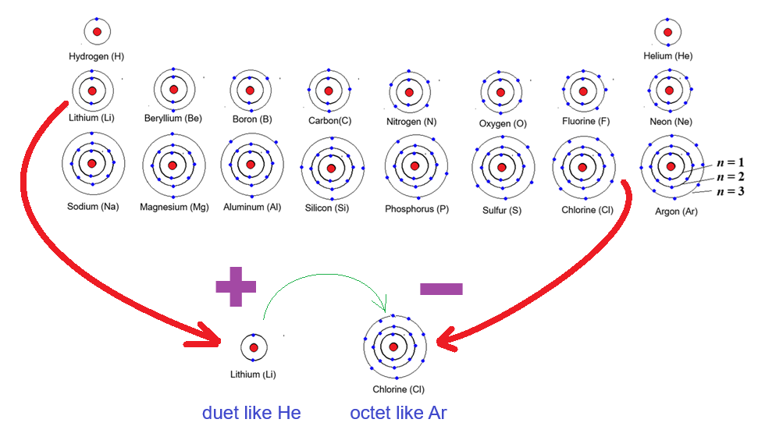
Wanting To Be Like Noble Gas Elements
Forming the octet (or duet) by ionization, to be an ionic compound

Slide 9
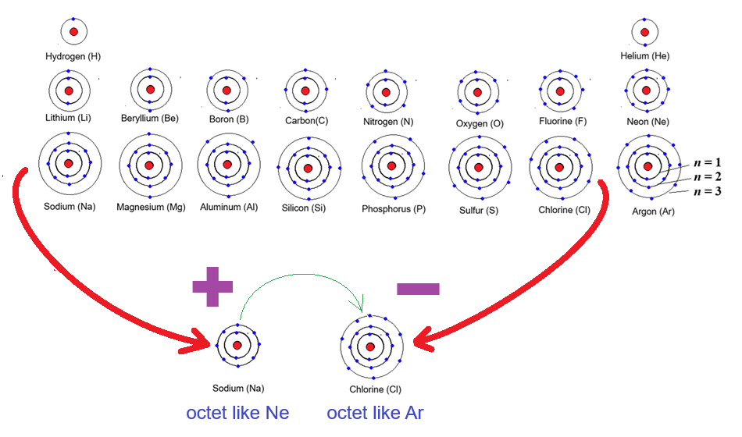
Wanting To Be Like Noble Gas Elements
Forming the octet by ionization, to be an ionic compound

Slide 10
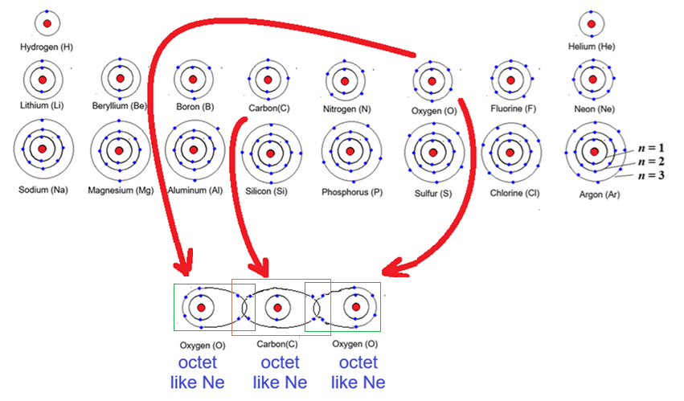
Wanting To Be Like Noble Gas Elements
Forming the octet through covalent bonding, or sharing.
The boxes count 8 electrons in valence (outermost) shells
Count them!

Slide 11
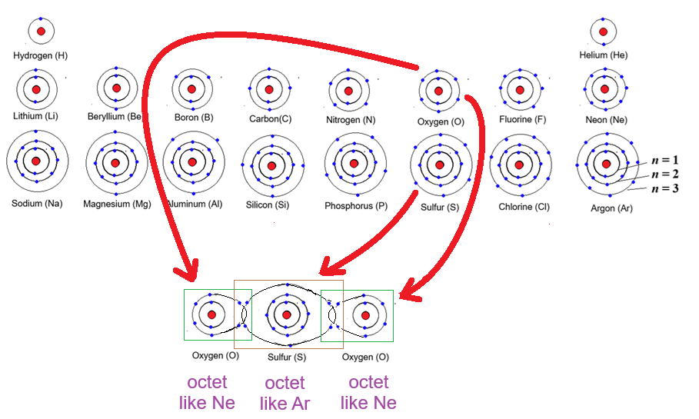
Wanting To Be Like Noble Gas Elements
Forming the octet through covalent bonding, or sharing.
The boxes count 8 electrons in valence (outermost) shells
Count them!

Slide 12










Electron Dot Diagramming
Lewis structures are the presentation of atoms with their valence (outermost shell of) electrons represented as dots
The dots can be placed around the element symbol top, right, bottom, left
The purpose of these diagrams are as an aid to chemists in showing the electrons available for BONDING of atoms to each other

Slide 13
Lewis Structures of Ionic Compounds
Sodium (Na) in Group I has 1 valence (outermost shell) electron. Getting rid of it

Slide 14
Lewis Structures of Covalent Molecules

Slide 15
Resonance

Slide 16
Octet Rule Exceptions

Slide 17
Molecular Shape Prediction

Slide 18
Electronegativity

Slide 19
Polarity

Slide 20
Intermolecular Forces
Dispersion
Dipole-Dipole
Hydrogen Bonding

